Slide 1
GSA’s Vendor and Customer Self Service (VCSS)
Notes:
Hello and welcome to GSA’s Vendor and Customer Self Service (VCSS) training course. This course has been developed to walk you through the navigation and functionality of VCSS. You are listening to Segment 1, Introduction

Slide 2

Payments Menu
View Customer Payments
Search for and view payments made to GSA for your accounts.
View Refunds
Search for and view refunds received from GSA for your accounts.
F1
Notes:
We are now going to walk through each of these Payments options in this section.

Slide 3

View Customer Payments
The Payment Search page is used to search for and view payments made to GSA on your account.
View payment details: payment number, invoice number, paid amount, and if collected through IPAC.
Create and view payment correspondence to send to GSA
Payment correspondence are messages regarding a specific payment made to GSA by your account. This correspondence should not be related to a general account issue or question, or a specific statement or refund on your account because there are specific types of correspondence that should be created for these.
To access Payment Search, from the menu bar select Payments > View Customer Payments.
F2
Notes:
The Payment Search page is used to search for and view payments made to GSA by your account.
From this page you can also create and view correspondence.

Slide 4
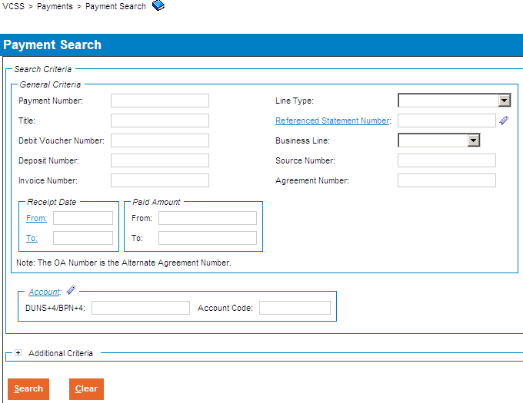
View Customer Payments (Cont’d)
Payment Search page
The Payment Search page displays with a search criteria area to search for payment records.
Enter search criteria and then select the [Search] button.
Note: The Payment Number is the internal GSA transaction number associated with a customer payment.
Customers should only search using the Payment Number field if the specific Payment Number has been provided by GSA.
F3
Notes:
The Payment Search page displays, with a search area to enter search criteria to search for payment records.

Slide 5
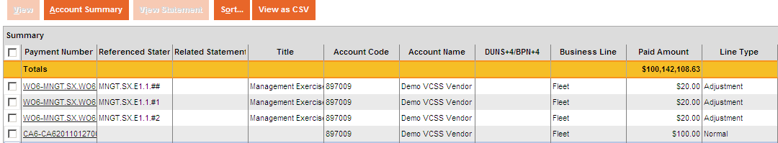
View Customer Payments (Cont’d)
Payment Search page
In the search results review the payment records.
F4
Notes:
After running the search for payment records, review the search results in the search results.
In the search results you have several options:
Select the [View] button to view the payment record details.
Select the [Account Summary] button to view a summary of the account associated with the payment.
Select the [View Statement] button to view the statement that the payment was made on.
Select the [Sort] button to sort the payment records.
Select the [View as CSV] button to export the payment records to a spreadsheet.
We are now going to review some of these options.

Slide 6
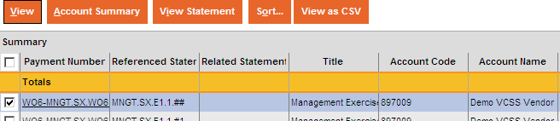
View Customer Payments (Cont’d)
Payment Search page
To view more detailed information about a payment, select a payment record and then select the [View] button.
F5
Notes:
You can view more detailed information about a payment by selecting a payment record and then clicking the [View] button.

Slide 7
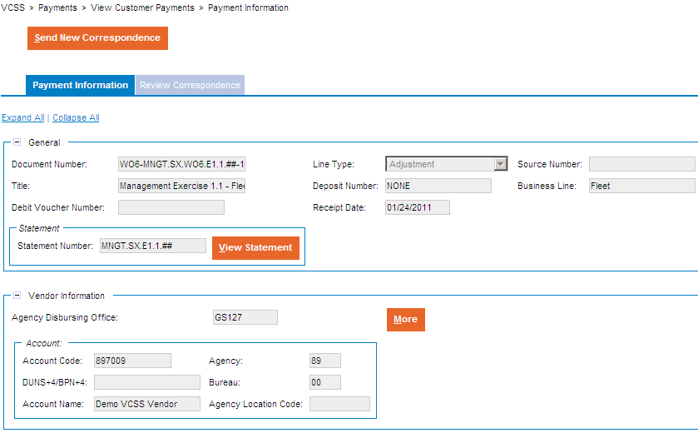
View Customer Payments (Cont’d)
Payment Record
The payment record opens and displays in a tab-like format. The first tab is the Payment Information tab where you can review detailed information about this payment.
F6
Notes:
The Payment record displays.

Slide 8
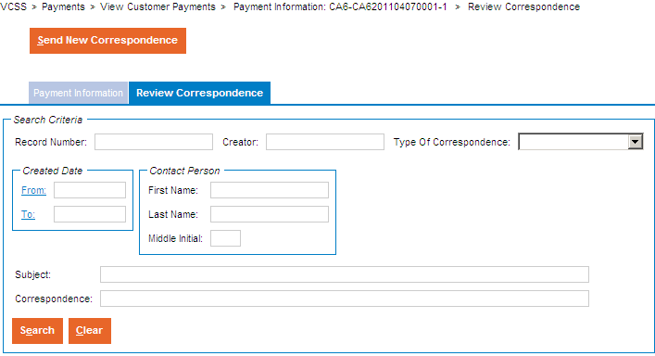
View Customer Payments (Cont’d)
Payment Record
Within the payment record, select the Review Correspondence tab to search for and review correspondence records associated with this payment.
Select the [Search] button without entering search criteria.
If you have access to a large number of correspondence records, you may want to enter search criteria and select the [Search] button to limit the search results to a manageable number.
F7
Notes:
Select the Payment record’s Correspondence tab.
You can search for correspondence that you or another person, in your organization, has already sent to GSA regarding this payment. You can also view correspondence that GSA has sent to your account regarding this payment.

Slide 9
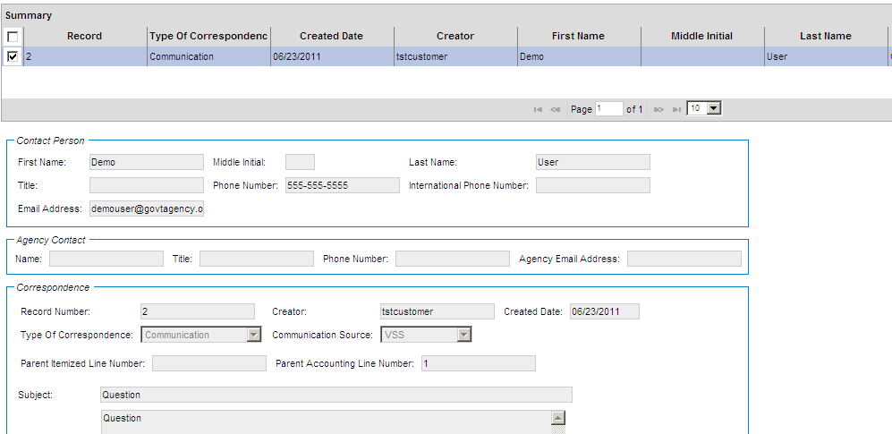
View Customer Payments (Cont’d)
Payment Record
In the search results, review the correspondence records.
To review the details of a payment correspondence record, select the correspondence record and then review the details that display below the search results.
F8
Notes:
To review detailed information for a payment correspondence record, simply select the record and review the details.

Slide 10
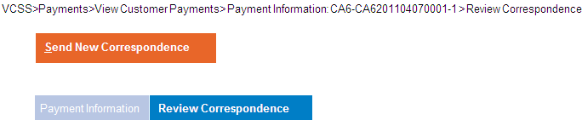
View Customer Payments (Cont’d)
Payment Record
Within the payment record, if you would like to create new correspondence to send to GSA regarding this payment, select the [Send New Correspondence] button.
F9
Notes:
To create new correspondence to send to GSA regarding this payment, select the [Send New Correspondence] button.

Slide 11
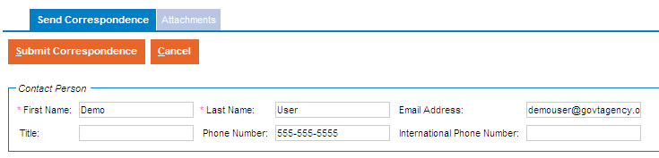
View Customer Payments (Cont’d)
Send Correspondence page
The Send Correspondence page displays. To send correspondence to GSA, fill out the following information:
Your contact, account, and correspondence information.
Add an attachment, if needed.
Select the [Submit Correspondence] button to send the correspondence to GSA. Once submitted, GSA will receive and review this correspondence.
F10
Notes:
Enter correspondence information regarding this payment, and then submit the correspondence.

Slide 12
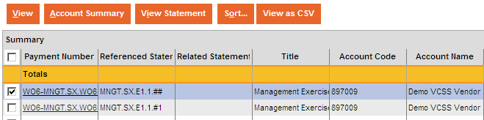
View Customer Payments (Cont’d)
Payment Search page
To view an account summary associated with a payment record, select a payment record and then select the [Account Summary] button.
F11
Notes:
You can review a summary of the account associated with the payment by clicking the [Account Summary] record.

Slide 13
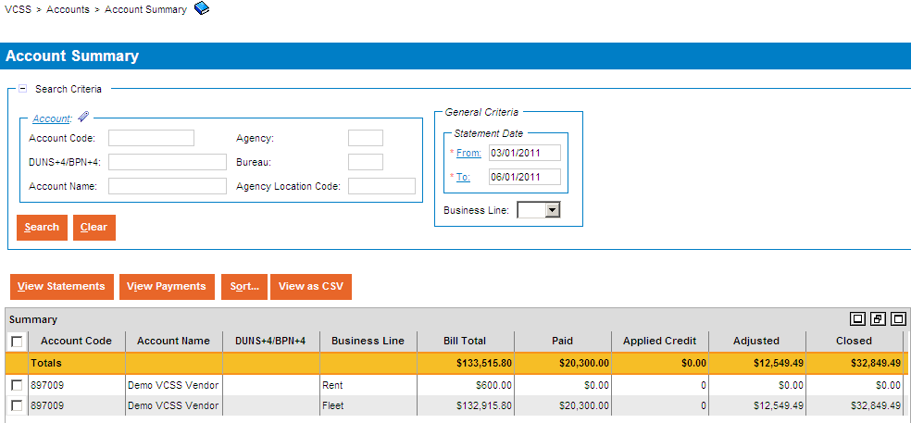
View Customer Payments (Cont’d)
Account Summary page
The Account Summary page displays with a search criteria area to search for and view account summary records associated with the selected payment record.
Enter search criteria and select the [Search] button to review account summary records.
F12
Notes:
The Account Summary page displays (we reviewed this in the Accounts section earlier in this presentation). You can search for and view the Account summary records associated with the selected payment record by entering the statement dates.

Slide 14
View Customer Payments (Cont’d)
Payment Search page
To view the statement that the payment was made on, select a payment record and then select the [View Statement] button.
F13
Notes:
You can review the statement that the payment was made on by clicking the [View Statement] button.

Slide 15

View Refunds
The Refunds Search page is used to search for and view refunds that GSA has made to your account.
View refund details, such as payment number, invoice number, and payment amount.
Create and view refund correspondence to send to GSA
Refund correspondence are messages regarding a specific refund on your account. This correspondence should not be related to a general account issue or question, or a specific statement or payment on your account because there are specific types of correspondence that should be created for these.
To access the Refunds Search page, from the menu bar select Payments > View Refunds.
F14
Notes:
The Refunds Search page is used to search for and view refunds that GSA has made to your accounts.

Slide 16
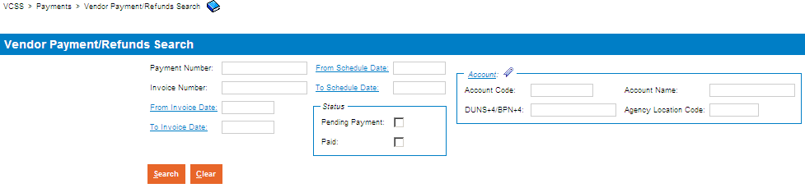
View Refunds (Cont’d)
Refunds Search page
The Refunds Search page displays with a search criteria area to search for refund records.
Enter search criteria and select the [Search] button.
F15
Notes:
The Refunds Search page displays, with a search area to enter search criteria to search for refund records.

Slide 17
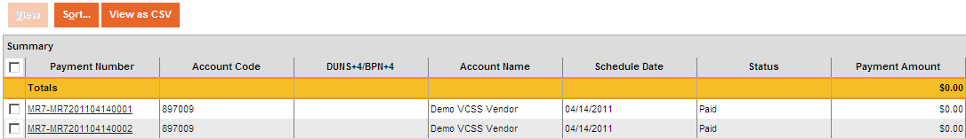
View Refunds (Cont’d)
Refunds Search page
In the search results, review the refund records.
F16
Notes:
After running the search for refund records, review the search results.
In the search results you have several options:
Select the [View] button to view the refund record details.
Select the [Sort] button to sort the refund records.
Select the [View as CSV] button to export the refund records to a spreadsheet.
We are now going to review how to view details of a refund.

Slide 18
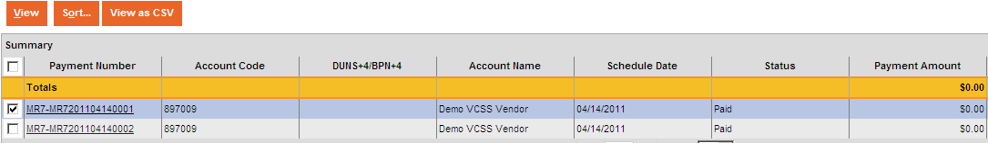
View Refunds (Cont’d)
Refunds Search page
To view more detailed information for a refund, select a refund record and then select the [View] button.
F17
Notes:
You can view detailed information about a refund by selecting a refund and clicking the [View] button.

Slide 19
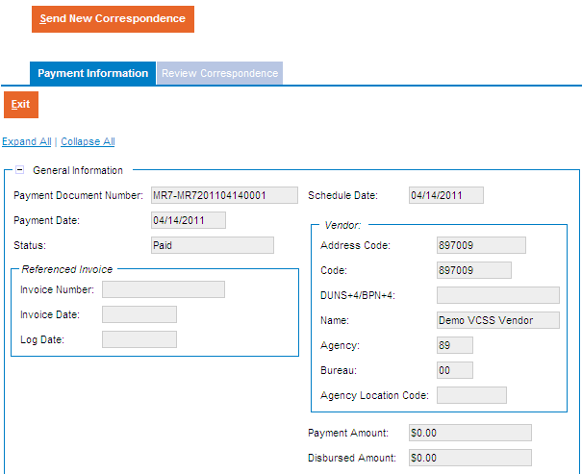
View Refunds (Cont’d)
Refund Record
The refund record opens and displays in a tab-like format. The first tab is the Payment Information tab where you can review detailed information about this refund.
F18
Notes:
The Refund record’s Payment Information tab displays.

Slide 20
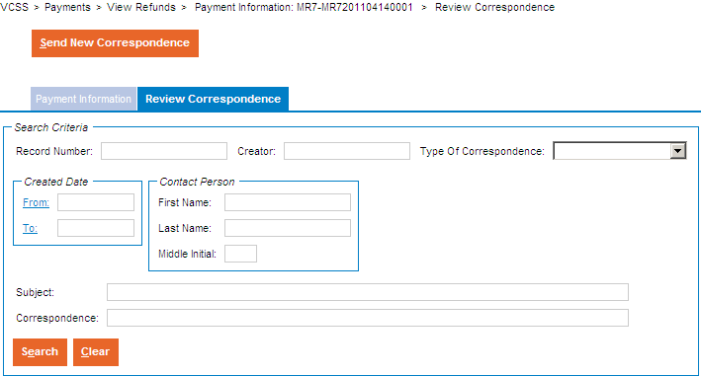
View Refunds (Cont’d)
Refund Record
Within the refund record, select the Review Correspondence tab to search for and review correspondence records associated with this refund.
Select the [Search] button without entering search criteria.
If you have access to a large number of correspondence records, you may want to enter search criteria and select the [Search] button to limit the search results to a manageable number.
F19
Notes:
Review the Correspondence tab to search for and review correspondence associated with this refund.

Slide 21
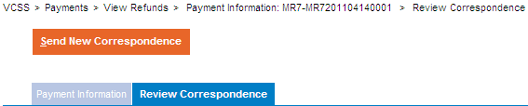
View Refunds (Cont’d)
Refund Record
Within the refund record, if you would like to create new correspondence to send to GSA regarding this refund, select the [Send New Correspondence] button.
F21
Notes:
If you want to create new correspondence to send to GSA regarding this refund, then select the [Send New Correspondence] button.

Slide 22
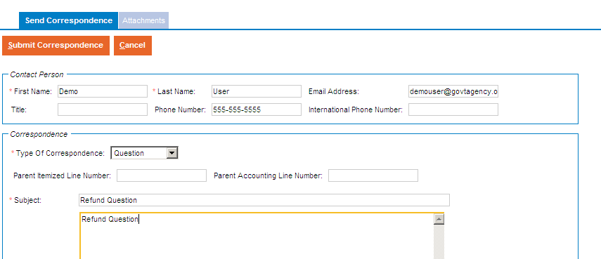
View Refunds (Cont’d)
Send Correspondence page
The Send Correspondence page displays. To send correspondence to GSA, fill out the following information:
Your contact, account, and correspondence information.
Add an attachment, if needed.
Select the [Submit Correspondence] button to send the correspondence to GSA. Once submitted, GSA will receive and review this correspondence.
F22
Notes:
Enter correspondence information and make sure to submit the correspondence when you are ready to submit it to GSA.

